Slide 1

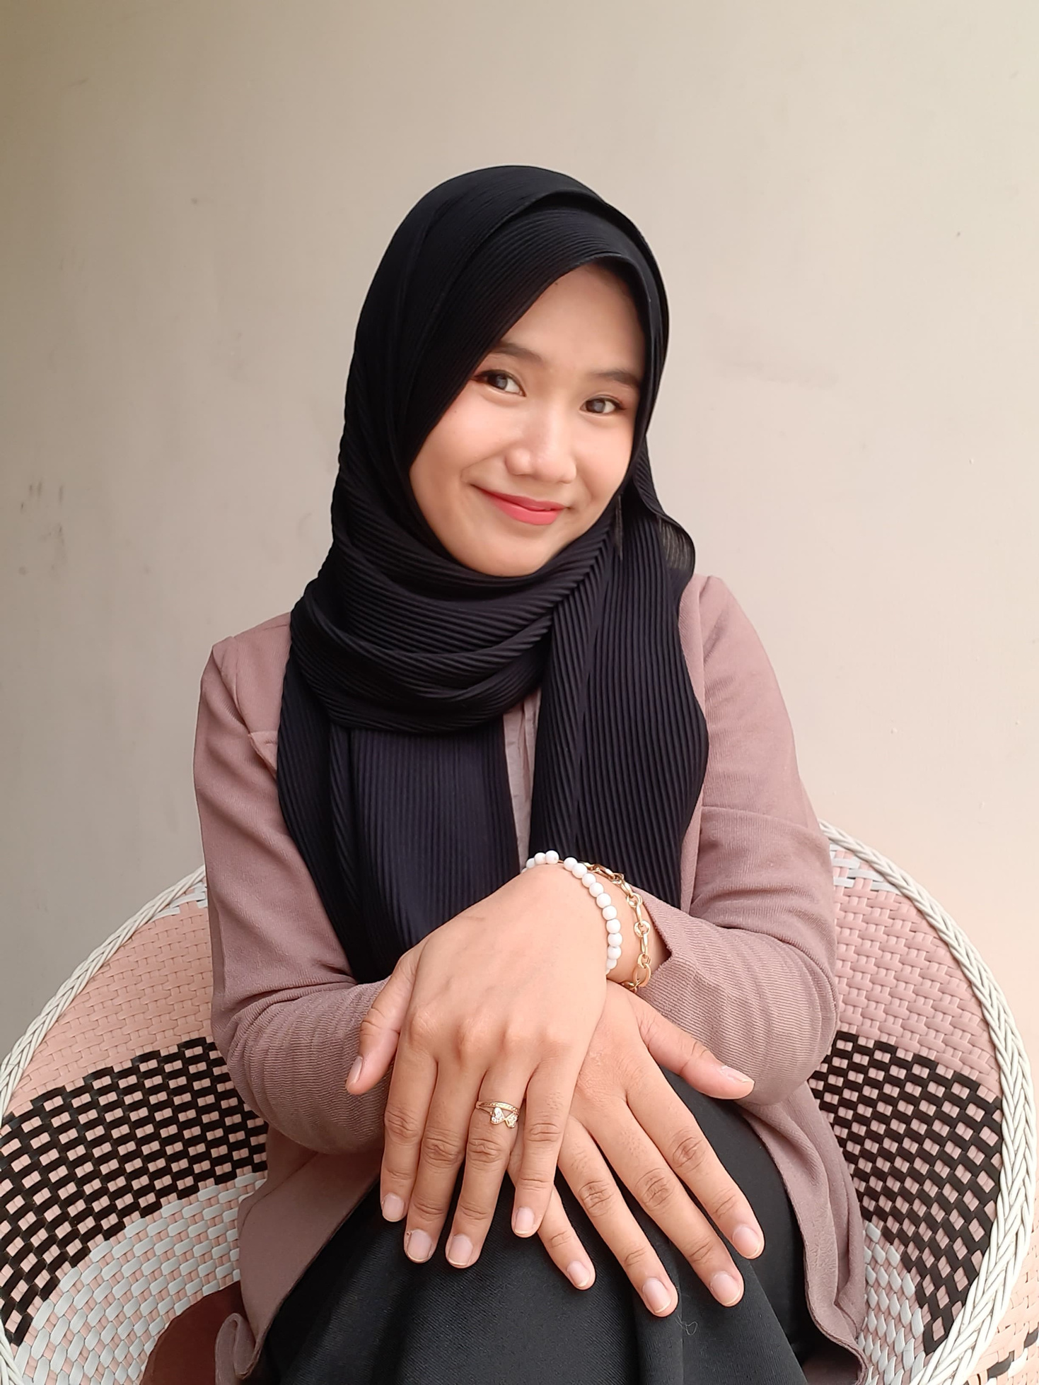
Mini Portfolio
Digital Skill Fair 33.0 - Data Science
@dibimbing.id
Machine Learning - Python
[ Logical Regression ]
By: Safirda Adini Rahmatsyah Putri

Slide 2

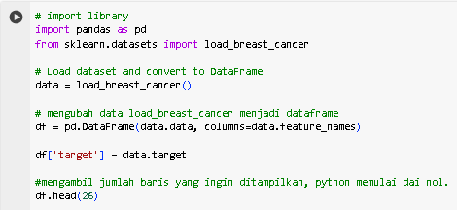

Load Dataset
Data Source:
load_breast_cancer from scikitlearn

Slide 3
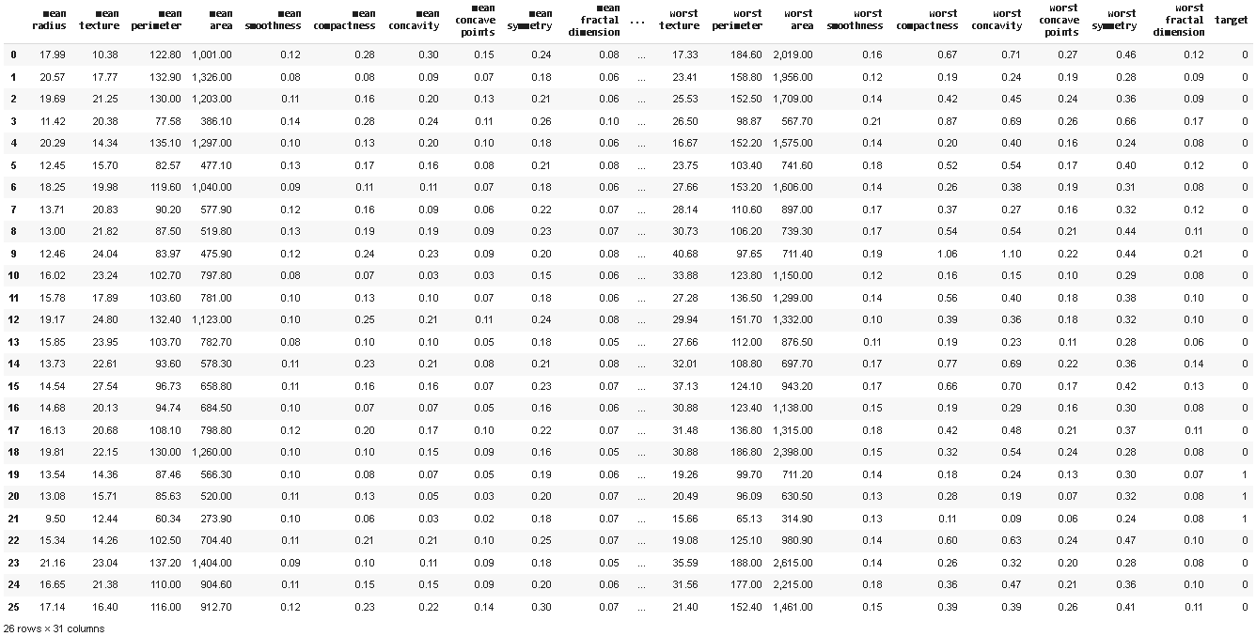

Load_Breast_Cancer DataFrame

Slide 4

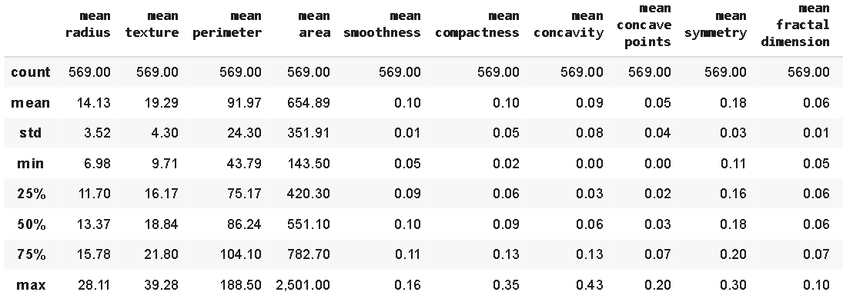
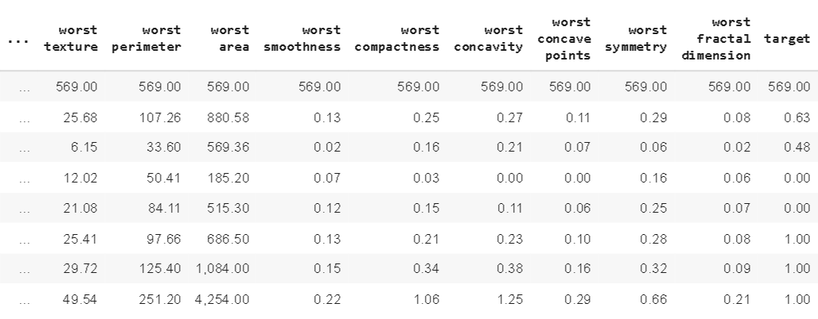
Display All Data In Statistical Format
Display All

Slide 5
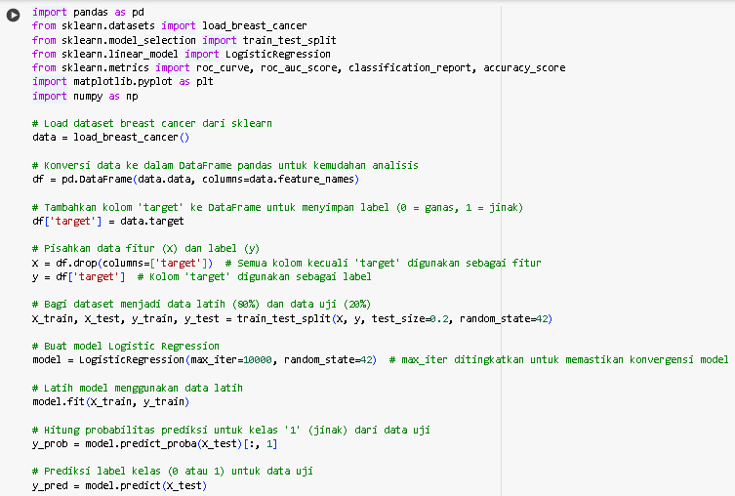
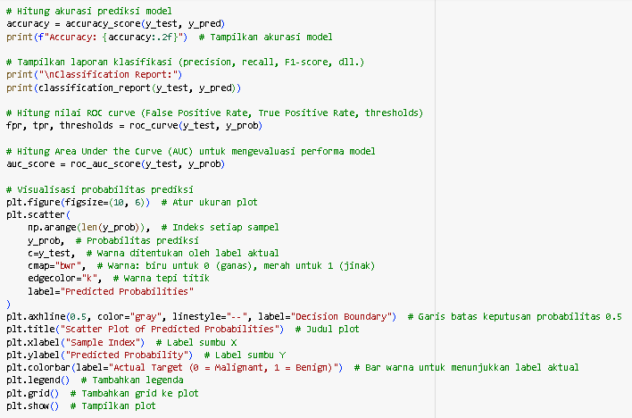
Accuracy & Visualization
Accura

Slide 6
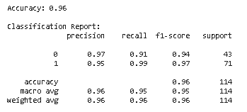
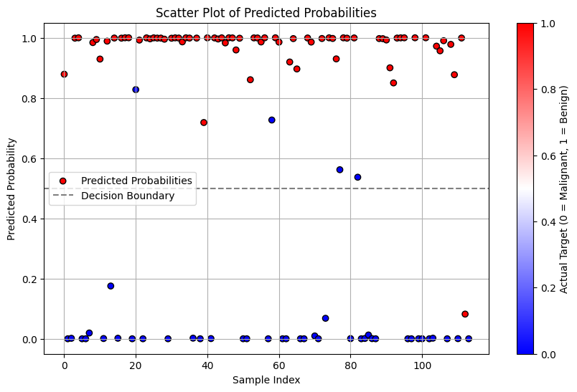
Accuracy
Visualization
0 = Malignant
1 = Benign

Slide 7
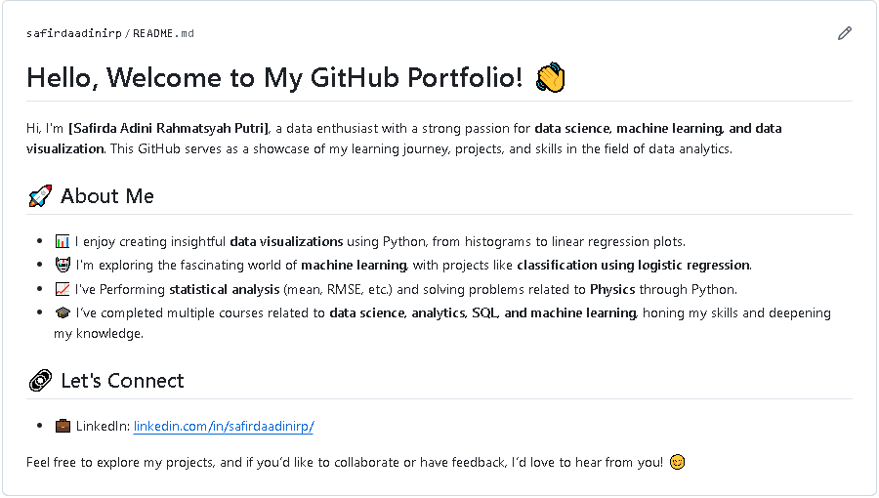
Accura
https://github.com/safirdaadinirp

Slide 8
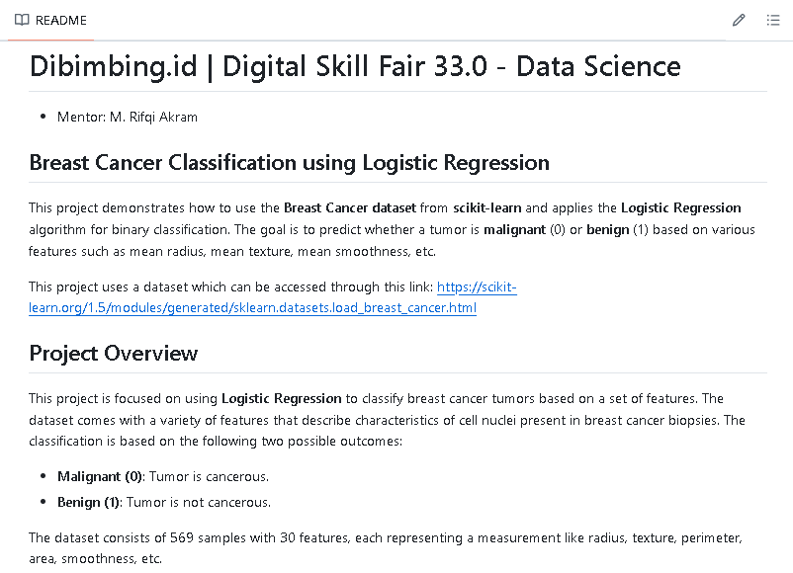
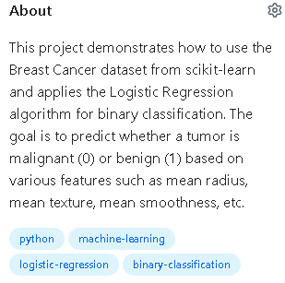

Slide 9
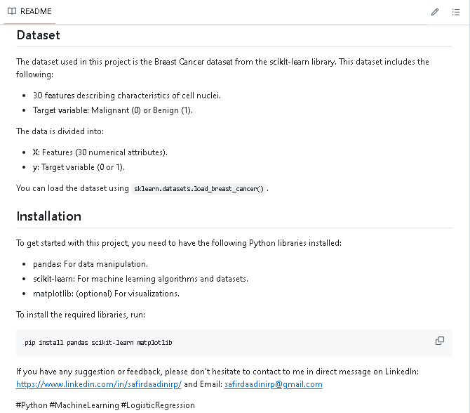

Slide 10



Thank You
Let’s Work
Together
safirdaadini

